Slide 1
Sequential VHDL
Module Convenor: Prof. T. Nandha Kumar
Email: nandhakumaar.t@nottingham.edu.my
Department of Electrical & Electronic Engineering
The University of Nottingham Malaysia Campus
EEEE4075/EEEE4076

Slide 2
Introduction
Sequential VHDL Code = VHDL codes that are executable in a sequence or in series.
Topics to be covered in this class
  Various sequential statements
  Behaviour of sequential statements
  Applications
EEEE4075/EEEE4076

Slide 3
Variable
Syntax
variable < signal> : < data type>;
Eg
variable sum1, sum2 : integer;
sum1 := sum1+1;
sum2 := sum1+1;
Implementation using signal:
signal sum1, sum2 : integer;
sum1 <= sum1+1;
sum2 <= sum1+1;
EEEE4075/EEEE4076

Slide 4
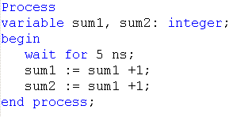
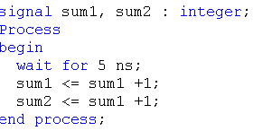
Variable (cont…)
Time (ns) | Sum1 | Sum2
0 | 0 | 0
5 | 0 | 0
5+delta | 1 | 1
10 | 1 | 1
10+delta | 2 | 2
15 | 2 | 2
15+delta | 3 | 3
Time (ns) | Sum1 | Sum2
0 | 0 | 0
5 | 1 | 2
5+delta | 1 | 2
10 | 2 | 3
10+delta | 2 | 3
15 | 3 | 4
15+delta | 3 | 4
EEEE4075/EEEE4076

Slide 5
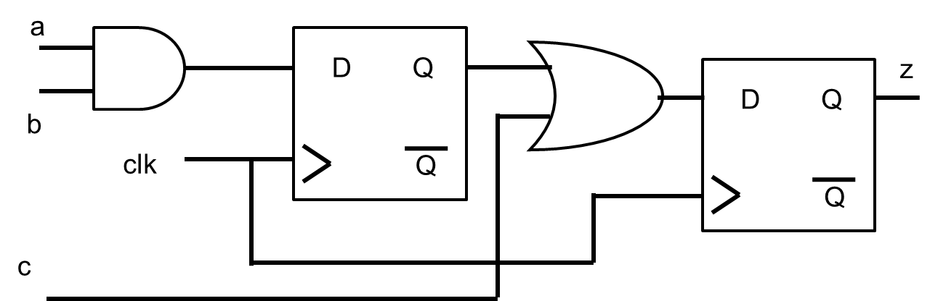
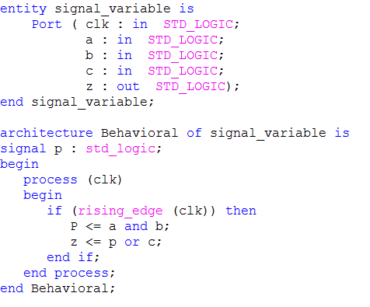
Signal
EEEE4075/EEEE4076

Slide 6
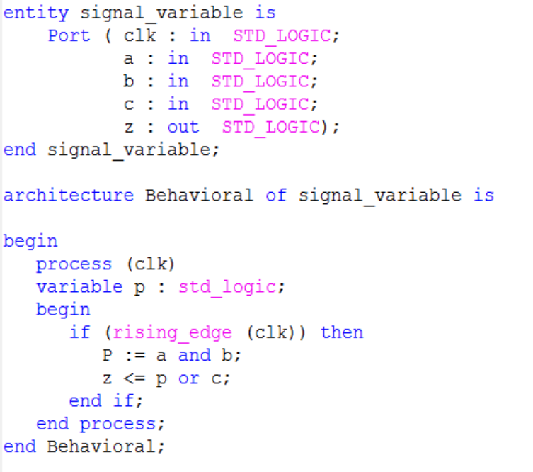
Variable
a
z
D Q
Q
b
c
clk
EEEE4075/EEEE4076

Slide 7
Variable Vs Signal
Can be declared and used only in sequential part of VHDL
uses symbol “ := “
The value is assigned to the variable immediately
Declared in concurrent part of VHDL , but can be used in both
concurrent and sequential part
Uses symbol “ <= “
The value is assigned to the signal after a delta time delay
Note: A variable needs the signal or port help to transfer its value outside the sequential part of the VHDL in which it is declared
EEEE4075/EEEE4076

Slide 8
Clock
clk ‘event and clk = ‘1’ - rising edge trigger
rising_edge (clock)
clk ‘event and clk = ‘0’ - falling edge trigger
falling_edge(clock)
clk = ‘1’ - level triggering
clk = ‘0’ - level triggering
EEEE4075/EEEE4076

Slide 9
VHDL Statements
Concurrent
  Signal
  When else
  With Select
  Process
Sequential
  Variable
  Codes in side Process
  If then else
  Case When
  Wait
  Loop
  Return
  Null
EEEE4075/EEEE4076

Slide 10
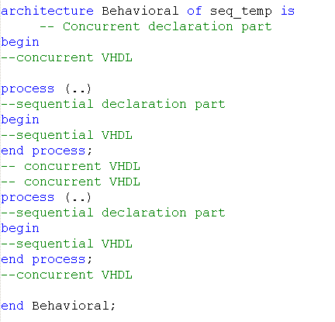
Where to use the VHDL Statements ?
Concurrent statement
Concurrent statement
Note: Codes in a Process is executed sequentially , several processes in an architecture are executed concurrently
EEEE4075/EEEE4076

Slide 11
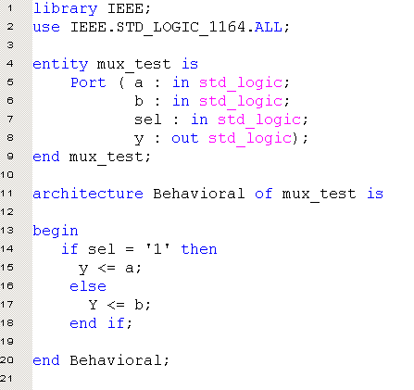
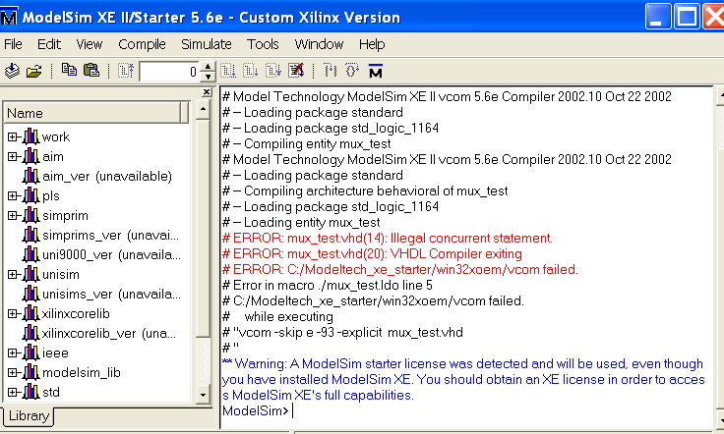
Any Errors !!!
EEEE4075/EEEE4076

Slide 12
Process
Syntax
< process name >: process < sensitivity list >
begin
….sequential statements
…..sequential statements
end process <process name>;
It is an infinite loop between begin and end process as long as the value in the sensitivity list changes
EEEE4075/EEEE4076

Slide 13
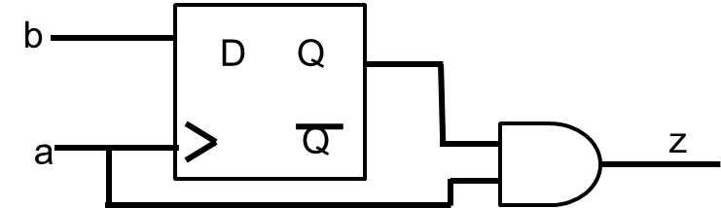
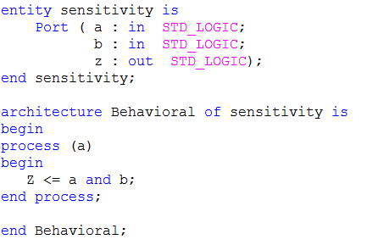
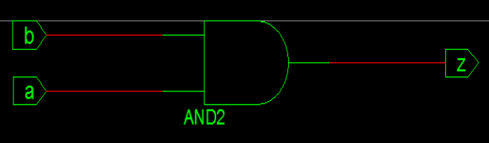
Missing Sensitivity list
WARNING:Xst:819 - "C:/Xilinx/10.1/ISE/ISEexamples/test/Bidirectionalbus/sensitivity.vhd" line 34: One or more signals are missing in the process sensitivity list. To enable synthesis of FPGA/CPLD hardware, XST will assume that all necessary signals are present in the sensitivity list. Please note that the result of the synthesis may differ from the initial design specification.
EEEE4075/EEEE4076

Slide 14
Process (cont…)
Sensitivity list
  activated if at least one signal changes its value
  Combinational logic – use all the signals used to describe the functionality
  Signals of a circuit described in side the process but they are missed/omitted to include in sensitive list by mistake will make the hardware to behave differently
  A process can be with out a sensitive list as well !!!
  Let us see some VHDL codes….
EEEE4075/EEEE4076

Slide 15
Reset
To reset the flip flop
Two methods of resetting a flip flop are
1. Asynchronous
2. Synchronous
EEEE4075/EEEE4076

Slide 16
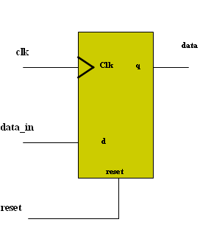
Asynchronous reset
The flip flop will be reset as soon as the reset is activated
Irrespective of the clock event
Sensitivity list should have both clk and reset
process ( clk, reset )
begin
if reset = ‘1’ then
data <= “00”;
else clk’ event and clk = ‘1’ then
data <= data_in ;
end if;
end process;
EEEE4075/EEEE4076

Slide 17
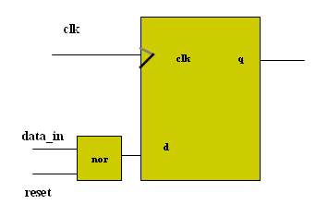
Synchronous reset
The flip flop is reset only at an active edge of the flip flop
Sensitivity list has only clk
process (clk)
begin
if clk’event and clk = ‘1’ then ;
if reset = ‘1’ then ;
q <= “00”;
else
q <= NOT data_in ;
end if ;
end if ;
end process;
reset tied to data_in !!!!
EEEE4075/EEEE4076

Slide 18
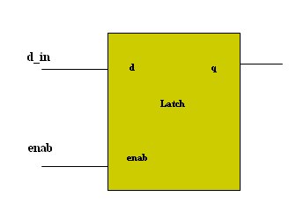
Latch
When the enable is activated , the value of d_in is propagated to the q
When the enable is deactivated, the value of q remains in the last value
process ( enab, d_in )
begin
if enab = ‘1’ then
q <= d_in;
end if;
end process;
What will happen if enable = ‘0’ ???
EEEE4075/EEEE4076

Slide 19
Implied Memory
No default value for the q
No else clause in the if statement
Then the value of q shouldn’t change when if condition is not satisfied.
The Boolean equation is
  q = enab data_in + enab q
When enab = 1 then q <= data_in
When enab = 0 then q <= q
The value of the q is remembered by the use of implied memory
Most of the FPGA tools warn this !
EEEE4075/EEEE4076

Slide 20
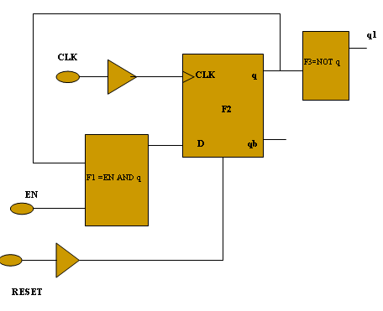
Process (cont…)
Architecture process_ex of ex is
signal q : std_logic;
begin
process (CLK, RESET);
begin
if RESET= ‘1’ then
q <= ‘0’;
elsif CLK’event and CLK=‘1’ then
if EN=‘1’ then
q <= q and EN;
else q <= last state;
end if;
end if;
end process;
q1 <= not q;
end ex_rtl;
Can an event on EN start the process?
Does D a signal or a port????
EEEE4075/EEEE4076

Slide 21
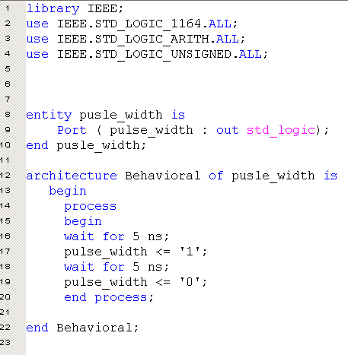
Process (cont…)
Create a pulse width of 5ns using process and wait statements
Note: A process with out sensitivity list should have wait statement.
EEEE4075/EEEE4076

Slide 22
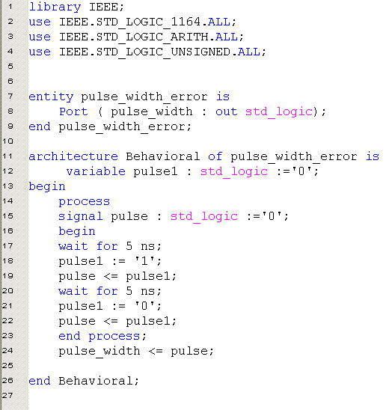
Process (cont…)
Find the errors if any!!!
Can the value of a signal inside the process statement be assigned to the port outside the process, while the process is executing the rest of the statement?
Does the nested process allowed?
Note: If multiple assignments are made to the same signal inside a process then only the last one to be evaluated has any effect
EEEE4075/EEEE4076

Slide 23
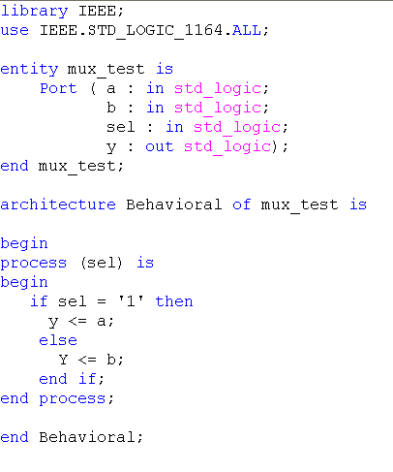
If Statement
Syntax
if < condition > then
< sequence_of_statements>
elsif <condition> then
< sequence_of statements>
else
<sequence_of_statements >
end if;
EEEE4075/EEEE4076

Slide 24
Case When
Syntax
case < expression > is
when < choice > => < sequence _of_statements > ;
when < choice > => < sequence_of_statements > ;
……
when others => < sequence_of_statements >;
end case;
EEEE4075/EEEE4076

Slide 25
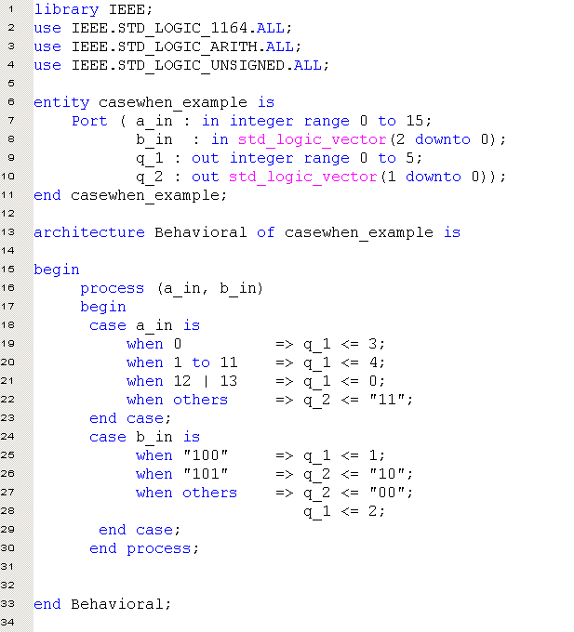
Case – when (cont…)
Various ways to code !!!
EEEE4075/EEEE4076

Slide 26
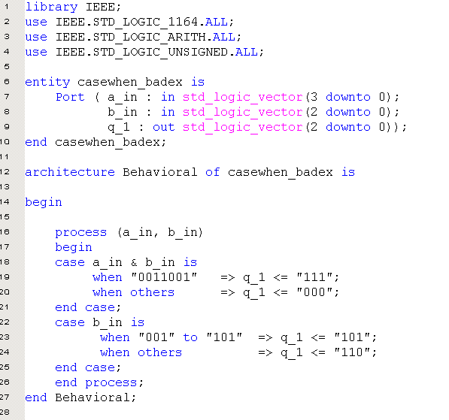
Case – when (cont…)
Wrong coding !!!!
EEEE4075/EEEE4076

Slide 27
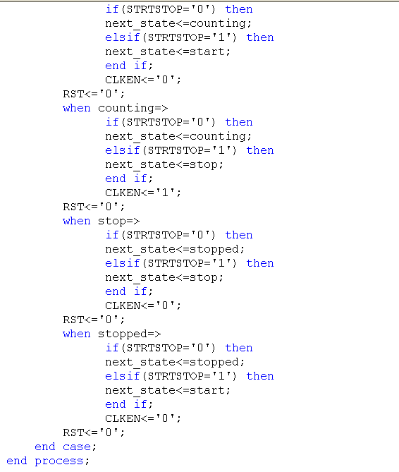
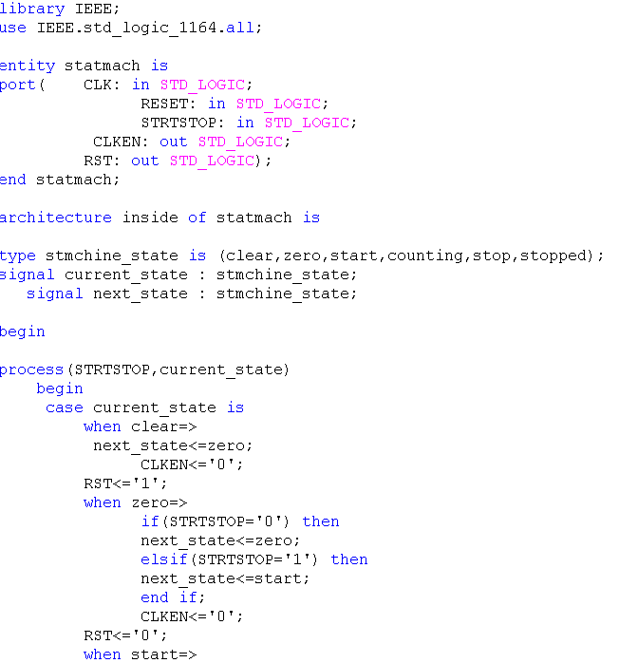
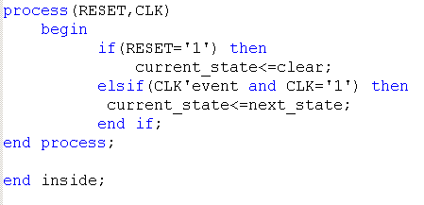
Case – when (cont…)
EEEE4075/EEEE4076

Slide 28
Null statement
Null statement means “ do nothing”
case a is
when “00” => q1 <= ‘1’ ;
when “11” => q1 <= ‘0’;
q2 <= ‘1’ ;
when others => null;
end case;
EEEE4075/EEEE4076

Slide 29
Loop statements
Two different types of loop statements are
1. For loop
2. While loop
EEEE4075/EEEE4076

Slide 30
For loop
Syntax
[ loop_label :] for < identifier > in < discrete_range > loop
sequence_of_statements
end loop [ loop_label ];
Eg.
Process (i)
begin
y <= i*i + 5;
For i in 1 to 5 loop
q(i) := a;
end loop;
end process;
Note: outside the for loop, i refers to the sensitivity list
inside the for loop, i refers to the local index
so the index value i is not same as object as the signal i .
No Declaration needed for ‘i’
EEEE4075/EEEE4076

Slide 31
Next
used in side the for loop
allows to stop the process of the current iteration and skip to the successor
loop variable is incremented to the next iteration value, provided iteration limit has not been reached.
In the case of nested loop, the process of iteration stops the particular loop if it has the next statement in it.
E.g..
process (a, b)
constant max : integer:= 100;
begin
For i in 0 to max loop
If (y(i) = a(i) or b (i)) then
next;
else
y(i) := a(i) or b(i) ;
end if;
q(i) <= a(i) nand b(i);
end loop;
end process;
EEEE4075/EEEE4076

Slide 32
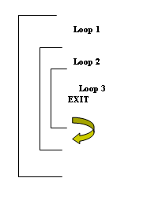
Exit
It is used inside the for loop
It is used to jump out of the loop currently in execution
If there is a nested loop, then exit is used to jump from the particular loop if it has the exit statement in it.
Three types of EXIT are
1. EXIT
2. EXIT with loop label
3. EXIT with a condition
EEEE4075/EEEE4076

Slide 33
Exit (cont…)
EXIT
Process (a)
begin
first_loop: for i in 0 to 50 loop
second_loop: for i in 0 to 100 loop
……
Exit;
……..
end loop;
end loop;
end process;
EXIT with loop label
Process (a)
begin
first_loop: for i in 0 to 50 loop
second_loop: for i in 0 to 100 loop
……
Exit second_loop;
……..
Exit first_loop;
………
end loop;
end loop;
end process;
EEEE4075/EEEE4076

Slide 34
Exit (cont…)
Exit with condition
Process (a)
begin
first_loop: for i in 0 to 50 loop
second_loop: for i in 0 to 100 loop
……
Exit first_loop when (i < 5);
……..
end loop;
end loop;
end process;
EEEE4075/EEEE4076

Slide 35
While loop
process (a, b, reset )
variable i: integer range 0 to 20;
begin
if reset = ‘0’ then
i:= ‘0’;
else
while q < 10 loop
if i = 14 then
exit;
else
i <= i + 1;
q <= a(i) or b(i) ;
end if ;
end loop;
end if;
end process;
Syntax
[loop_label:] while < condition > loop
sequence_of_statement
end loop [loop_label];
EEEE4075/EEEE4076

Slide 36
Counter Design
Library ieee;
Use ieee.std_logic_1164.all;
Use ieee.std_logic_unsigned.all; --essential for this to run
Entity counter is
Port (clk: in std_logic;
Reset: in std_logic;
count: out std_logic_vector (3 downto0));
End counter ;
Architecture counter_arch of counter is
Signal intcount: std_logic_vector (3 downto0);
begin
Counter : process (clk)
begin
If clk'event and clk='1‘ then
If Reset='0' then --sync reset (active low)
Intcount <= (others=>'0');
elsif intcount ="1111“ then --mod 16 counter
Intcount <= (others=>'0'); --all bits to zero
else
Intcount <= intcount + '1'; --count -ok for either 1 or '1'
end if;
end if; --end of clock edge condition
end process counter;
Count <=intcount; --transfer internal signal to the output (count)
end architecture counter_arch;
EEEE4075/EEEE4076

Slide 37
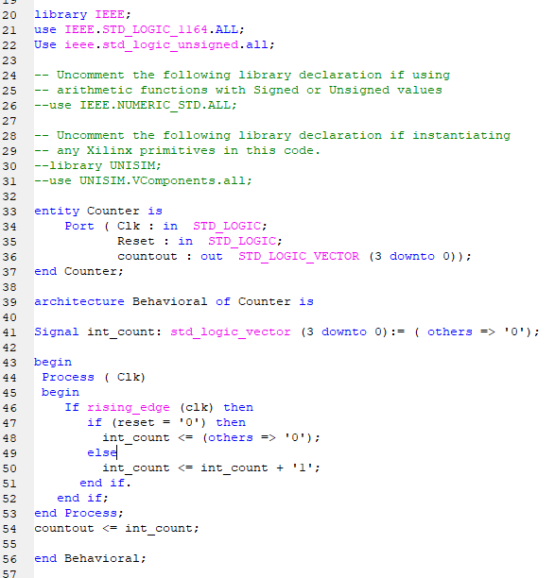
Counter Design
EEEE4075/EEEE4076

Slide 38
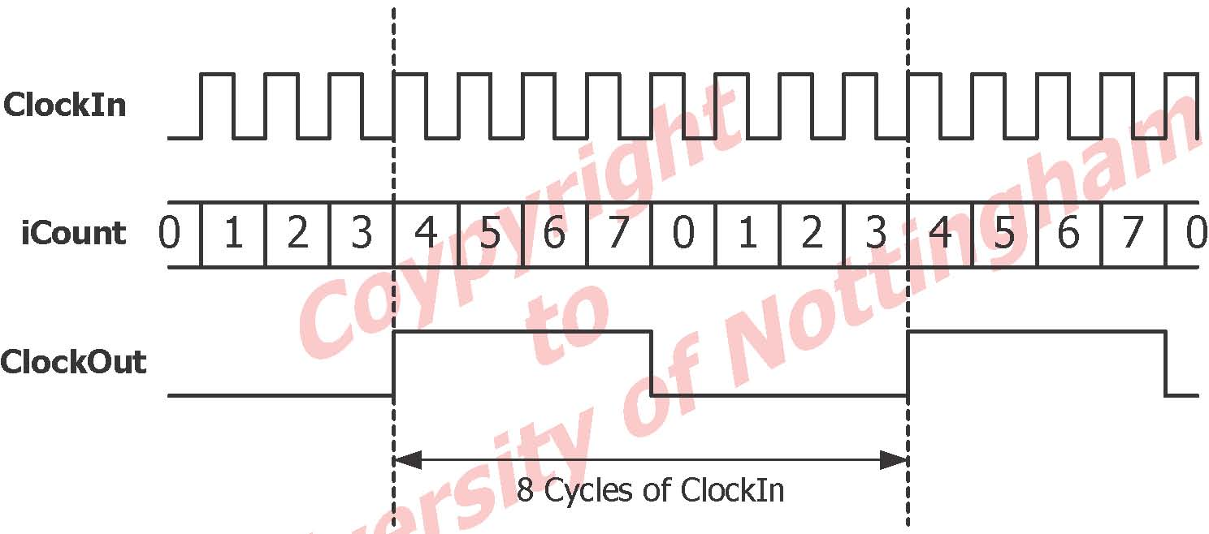
Case Study: Clock Divider
EEEE4075/EEEE4076

Slide 39
Case Study : A Clock Divider
Library ieee;
Use ieee.std_logic_1164.all;
Use ieee.std_logic_unsigned.all;
Entity ClockDivider is
Port (ClockIn: in std_logic; ClockOut: out std_logic);
End ClockDivider;
Architecture Arch_ClockDivider of ClockDivider is
Signal iCount3: std_logic_vector (2 downto 0) := (others=> '0');
begin
process(ClockIn)
begin
If ClockIn'event and ClockIn='1' then
iCount3 <= iCount3 + '1';
end if;
end process;
ClockOut <= iCount3(2);
End Arch_ClockDivider;
EEEE4075/EEEE4076

Slide 40
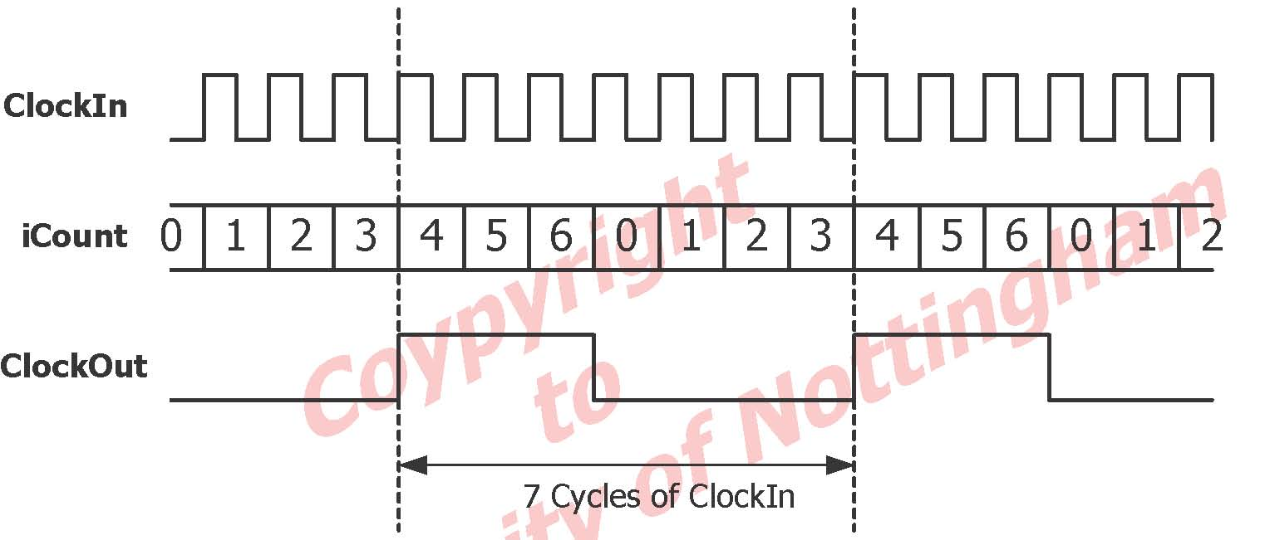
Generic Clock Divider
EEEE4075/EEEE4076

Slide 41
Generic Clock Divider
architecture Arch_ClockDivider of ClockDivider is
Signal iCount3: std_logic_vector (2 downto0) := (others=> '0');
begin
process (ClockIn)
begin
If ClockIn'event and ClockIn='1' then
if iCount3 = “110”then
iCount3 <= (others=>’0’);
else
iCount3 <= iCount3 + '1';
end if;
end if;
end process;
ClockOut <= iCount3(2);
end Arch_ClockDivider;
EEEE4075/EEEE4076

Slide 42
Case Study: Signal Vs Variable
--This file shows the difference between signals and variables
library ieee;
use ieee.std_logic_1164.all;
use ieee.std_logic_unsigned.all;
entity SignalVariableis
port (
Reset, Clk:instd_logic;
SigNumOut, SigSumOut, VarNumOut, VarSumOut: out std_logic_vector (3 downto0));
end entity SignalVariable;
architecture behv of SignalVariable is
signal iSigNum, iSigSum: std_logic_vector(3 downto0);
begin
sig: process(Reset, Clk) --signal part of process
begin
if Reset = '1'then
iSigNum<= "0000";
iSigSum<= "0000";
elsif Clk'eventandClk='1‘ then
iSigNum<=iSigNum+'1';
EEEE4075/EEEE4076

Slide 43
Case Study: Signal Vs Variable
iSigSum<=iSigSum+iSigNum;
end if; --end of clocked section
end process sig;
SigSumOut <= iSigSum; --needed in order to see the effect at the output in the simulator
SigNumOut <= iSigNum; --again
var: process (Reset, Clk) --variable part of process
variable iVarNum, iVarSum: std_logic_vector (3 downto0);
begin
If Reset = '1‘ then
iVarNum:="0000";
iVarSum:="0000";
elsif Clk'eventandClk='1‘ then
iVarNum := iVarNum+'1'; --updates immediately
iVarSum := iVarSum+iVarNum; --updates immediately
end if; --end of clocked section
VarSumOut <= iVarSum; --needed in order to see the value of vsum
VarNumOut <= iVarNum; --needed in order to see the value of vnum
end process var;
end architecture behv;
EEEE4075/EEEE4076

Slide 44
Case Study: Signal Vs Variable
library ieee;
use ieee.std_logic_1164.all;
use ieee.std_logic_unsigned.all;
entity tb_SignalVariable is
end tb_SignalVariable;
architecture behav of tb_SignalVariable is
component SignalVariable
port(
Reset, Clk: in std_logic;
SigNumOut, SigSumOut, VarNumOut, VarSumOut: out std_logic_vector (3 downto0));
end component;
signal tb_Reset, tb_Clk: std_logic;
signal tb_SigNumOut, tb_SigSumOut, tb_VarNumOut, tb_VarSumOut: std_logic_vector (3 downto0);
constant period : time := 10ns;
EEEE4075/EEEE4076

Slide 45
Case Study: Signal Vs Variable
begin
DUT : SignalVariable port map (
Reset=>tb_Reset,
Clk=>tb_Clk,
SigNumOut=>tb_SigNumOut,
SigSumOut=>tb_SigSumOut,
VarNumOut=>tb_VarNumOut,
VarSumOut=>tb_VarSumOut);
process --produce clock signal
begin
tb_Reset <= '1'; wait for 1.5*period; tb_Reset <= '0'; wait;
end process;
process --produce reset signal
begin
tb_Clk<= '1'; wait forperiod/2; tb_Clk<= '0'; wait forperiod/2;
end process;
end behav;
EEEE4075/EEEE4076

Slide 46
Case Study: For loop
Consider a 3 bit signal, X, where we wish to count the number of bits in this signal that are equal to 1
library ieee;
use ieee.std_logic_1164.all;
entity num_bits is
port (X : in std_logic_vector(1 to3);
count: buffer integer range 0 to3);
end entity num_bits;
Architecture behv of num_bits is
begin
P1: process(X)
begin
count <= 0; --the 0 with no quotes is a decimal number
for i in1 to3 loop
if X(i)=‘1’ then
count <= count+1;
end if;
end loop;
end process P1;
end architecture behv;
‘count’ is an integer with its values limited to 0-3 i.e it is a 2 bit unsigned integer (see the range statement)
‘count’ is of mode buffer which allows it to be used on both LHS and RHS of signal assignments
‘count’ is initially set to zero inside the process –it is an integer so no quotes.
Remember signal assignments inside a process are not updated until just after the end of the process
Hence if any bit of X(i) is ‘1’then the statement ‘count<=0;’will be overwritten before it leaves the process
We can achieve the desired behaviour by using a variable
EEEE4075/EEEE4076

Slide 47
Case Study: For loop
Library ieee;
Use ieee.std_logic_1164.all;
Entity num_bits is
Port (X :instd_logic_vector(1 to3);
count: bufferinteger range0 to3);
end entity num_bits;
Architecture behv2 of num_bits is
begin
P1: process (X)
variable tmp: integer;
begin
tmp:=0;
for i in1 to3 loop
If X(i)=‘1’then
tmp:= tmp+1;
end if;
end loop;
count <= tmp;
end process P1;
end architecture behv2;
We now use the variable ‘tmp’ instead of ‘count’ inside the process
the values are not scheduled to the end of the process but are updated immediately
Firstly ‘tmp’ will be assigned to zero immediately before entering the for loop
Then we enter the for loop and ‘tmp’ will genuinely add up the number of bits in the whole of X before leaving the loop
Just before leaving the process the value of ‘tmp’ is passed to ‘count’
EEEE4075/EEEE4076

Slide 48
Questions
Where are variables declared?
Give an example of an attribute
How do you use a variable outside a process?
What does ‘operator overloading’ mean?
Name a package that allows operator overloading.
What problem do you get with an if clause if all the conditions are not covered?
Name a short form for “if CLK’event andCLK=‘0’ then”?
Who provides the packages std_logic_signed and std_logic_unsigned?
Name all of the control statements available in a process?
State two ways of using the numeric operators on std_logic.
A process without a sensitivity list is illegal?
What does ‘operator overloading’ mean?
Inside a process when would you use signal assignments?
EEEE4075/EEEE4076

Slide 49
True/False
A signal is updated immediately?
A variable is updated at the end of a process?
A variable assignment statement inside a process is sequential?
A signal assignment statement inside a process is sequential?
The first assignment inside a process will dominate?
Q <= Q+1; is a variable assignment?
You can assign a value to a constant only once?
A variable can only be read?
A variable is local to a process?
A for loop can be used outside a process?
A case statement is equivalent to a selected signal assignment
A next statement in a while loop will jump out of the loop?
The variable I in a for loop must be declared beforehand?
An integer of range 0-31 is a 5 bit unsigned integer?
A list such as 7|8|9 in a while loop means 7 and 8 and 9 ?
The first signal assignment statement in a process determines the final value?
EEEE4075/EEEE4076

Slide 50
Exercise 5
1. Using a process statement design a counter that will count , a signal, Q, up to 256 and set a flag using a signal ‘OVERFLOW’ to ‘1’ when Q is > 8 or to ‘0’ if it is < 8.
2. An integer k is used in a counter. Write a VHDL code which uses an if statement that sets a variable even to ‘1’if the integer, k, is even, or sets even to ‘0’if k is odd.
EEEE4075/EEEE4076

Slide 51
Exercise 5
Simulate those two clock dividers in case studies by using the following given testbench
library ieee;
use ieee.std_logic_1164.all;
entity tb_clockDivider is
end tb_clockDivider;
architecture behav of tb_clockDivider is
component ClockDivider
port (ClockIn :in std_logic; ClockOut: out std_logic);
end component;
signal tb_ClockIn, tb_ClockOut: std_logic;
constant period : time := 10 ns;
begin
DUT : ClockDivider port map(
ClockIn=>tb_ClockIn,
ClockOut=>tb_ClockOut);
process --produce clock signal;
begin
tb_ClockIn <= '1';
wait for period/2;
tb_ClockIn <= '0';
wait for period/2;
end process;
end behav;
EEEE4075/EEEE4076

Slide 52
END of Lecture 5
EEEE4075/EEEE4076

